Slide 1

COMPUTER NETWORKS MODULE 2
By
Dr. Kanchan Shende

Slide 2
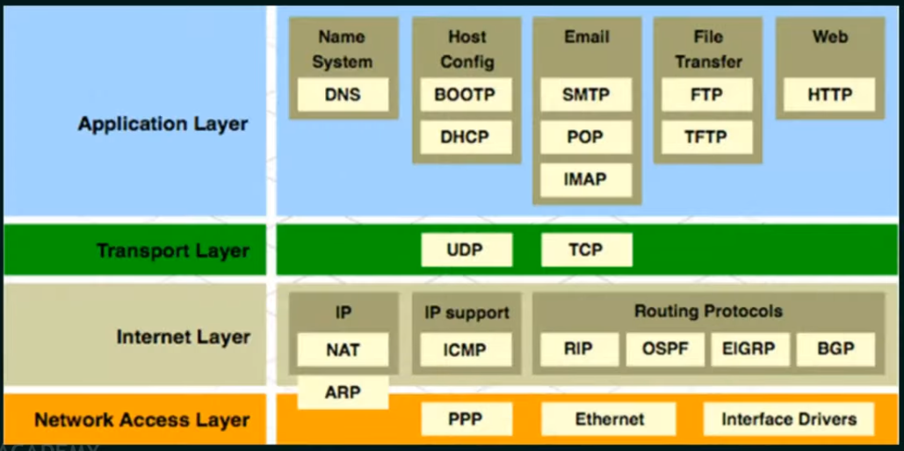
TCP/IP Reference Model
SOCS, MIT-WPU

Slide 3
Difference between TCP/IP and OSI Model
TCP/IP Model | OSI Model
TCP refers to Transmission Control Protocol. | OSI refers to Open Systems Interconnection.
TCP/IP has 4 layers. | OSI has 7 layers.
TCP/IP is more reliable | OSI is less reliable
TCP/IP uses both session and presentation layer in the application layer itself. | OSI uses different session and presentation layers.
TCP/IP developed protocols then model. | OSI developed model then protocol.
Transport layer in TCP/IP does not provide assurance delivery of packets. | In OSI model, transport layer provides assurance delivery of packets.
Protocols cannot be replaced easily in TCP/IP model. | While in OSI model, Protocols are better covered and is easy to replace with the change in technology.
SOCS, MIT-WPU

Slide 4
Addressing : Physical, Logical and Port addresses
Physical Address
Whatsoever network you are in LAN or WAN, it provides a different address to all the nodes in the network. This address is a physical address and it is also termed as link address.
The physical address is the lowest level of address. This means the physical address is specifically for intra-networking environment. Using physical addressing a node can send a frame to another node in the same physical network
SOCS, MIT-WPU

Slide 5
Conti…
The physical address can be further classified into
Unicast : The physical unicast address is assigned to the frame that has to be sent to a single recipient.
Multicast : Physical multicast address is included in the frame that has to be sent to a group of recipients.
Broadcast address : The physical broadcast address is included in the frame that has to be sent to all the nodes or all the system connected in the network.
SOCS, MIT-WPU

Slide 6
Conti…
Logical Address :
Logical addressing has a broader aspect and it is used to send the frame between two different networks which may have different addressing format.
Logical addressing is specially designed to identify each node uniquely irrespective of their underlying physical network.
The logical address is the IP address that is provided to the nodes connected to the internet and no two nodes here can have the same IP address.
SOCS, MIT-WPU

Slide 7
Conti…
Like physical address, the logical addresses are classified to
Unicast (single receiver),
Multicast (multiple receivers)
Broadcast (all the nodes of the system).
SOCS, MIT-WPU

Slide 8
Conti…
Port Address :
Once the data is received at the computer the next stage is to identify to which process in the computer the data has to be supplied.
The computer runs multiple processes at a time. So, to identify for which process the data has arrived we need to label the process to identify each process in a computer uniquely.
In TCP/IP architecture the address of a process is termed as port address.
SOCS, MIT-WPU

Slide 9
Practice Questions
What is OSI Reference Model? Explain in details with example
What is TCP/IP Reference Model ? Explain in details.
Difference between OSI and TCP/IP Model
What is advantages and Disadvantages of OSI and TCP/IP Model.
What is mean by address and types of addresses?
List the layers of the Internet model.
Which layers in the Internet model are the network support layers?
What are the concerns of the physical layer in the Internet model?
9. What are the responsibilities of the data link layer in the Internet model?
10. What are the responsibilities of the network layer in the Internet model?
II. What are the responsibilities of the transport layer in the Internet model?
12. What is the difference between a port address, a logical address, and a physical
address?
13. Name some services provided by the application layer in the Internet model.
14. How do the layers of the Internet model correlate to the layers of the OSI model?
SOCS, MIT-WPU

Slide 10
Reference Link
https://electronicsguide4u.com/computer-network-addressing-basic-overview/
https://byjus.com/free-ias-prep/difference-between-tcp-ip-and-osi-model/#:~:text=What%20is%20the%20main%20difference,a%20network%20can%20be%20described.
https://www.tutorialspoint.com/difference-between-osi-and-tcp-ip-reference-model
Book : Computer Networks by Behrouz A. Forouzan (Chapter 2 : Network Model)
SOCS, MIT-WPU

